Slide 1
Steppingblocks Digital Career Counselor
Career Outcomes Data at your Fingertips!

Slide 2
Agenda
Why Career Outcomes Data?
Explore Career Outcomes Data with Digital Career Counselor
An overview of the platform:
Home Feeds Page
Personality Assessment
Outcomes
Search 360
Tuition Analyzer
Job Board
Next Steps: Get Access & Learn More

Slide 3
Why Career Outcomes Data?
Have you ever asked yourself:
What can I do with my major? What have other people done with this major?
What are my career options?
What skills do I need to succeed?
With Career Outcomes Data You Can…
Discover top job titles, companies, salary, and more for people with your major
Learn more about the top skills for your desired field
Explore career paths from real people
Make informed academic and career decisions

Slide 4
Explore Career Outcomes Data with
Steppingblocks’ Digital Career Counselor
Digital Career Counselor…
is a platform designed specifically to give college students access to helpful career data
contains data from 135+ million people across the United States
has the information you need to make informed career decisions
Access Digital Career Counselor using your *SCHOOL NAME* Single Sign-On Credentials: *WEBSITE AND/OR QR CODE*

Slide 5
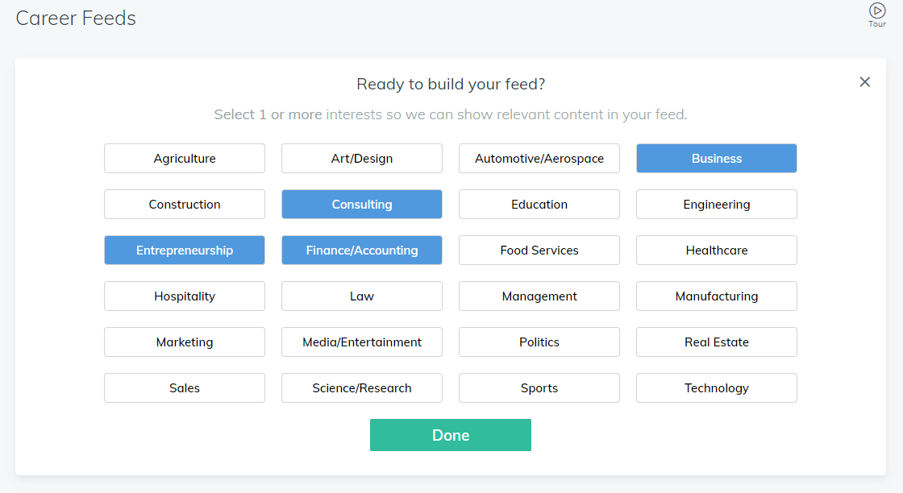
Module: Home (Career Feed)
With this Module you can…
Click on interest areas you want to learn more about
View YouTube videos and infographics related to those areas of interest
Use the Search Bar to search for additional resources

Slide 6
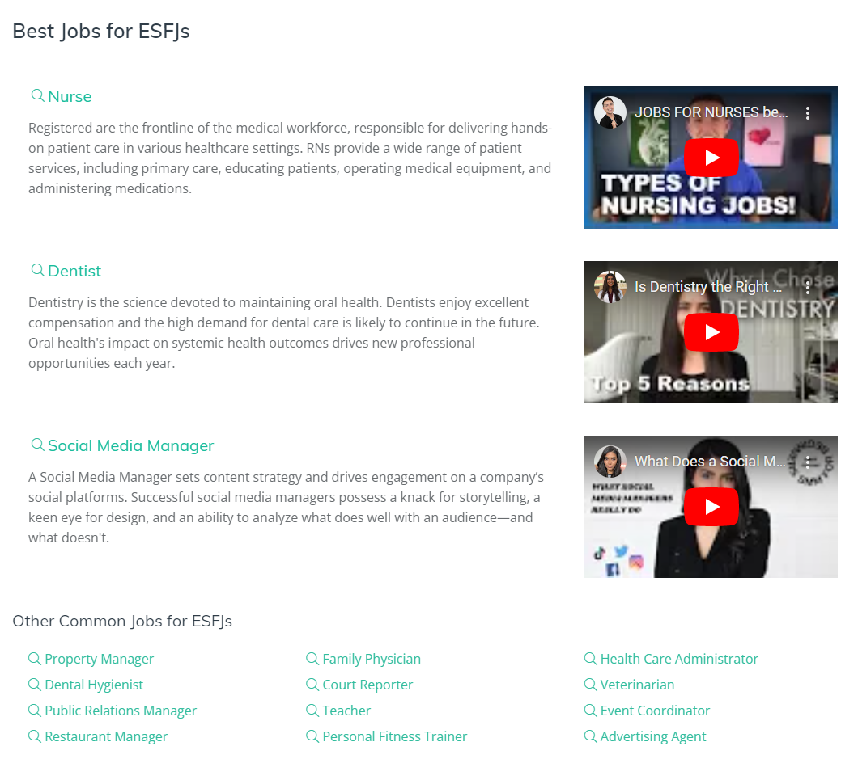
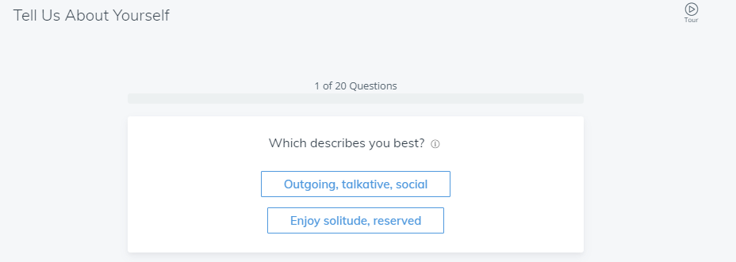
Module: Personality
With this Module you can…
Take a quick, 20-question personality assessment
Learn more about your personality type by downloading your custom personality report
Explore best and most common majors and jobs for your personality type

Slide 7
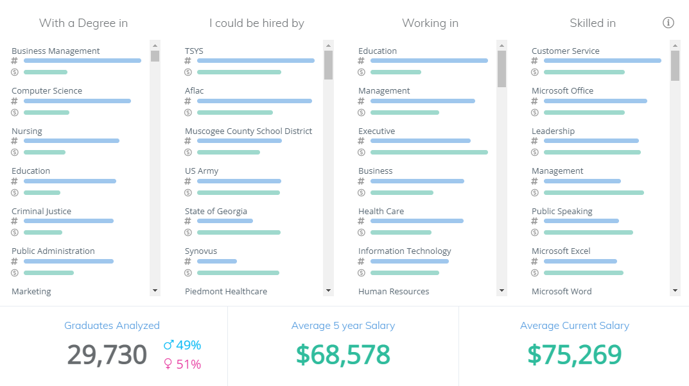
Module: Outcomes
With this Module you can…
Explore career outcomes data from your fellow *SCHOOL NAME* alumni
Filter the data by major, employer, job category, and/or skill
View salary information and common jobs

Slide 8
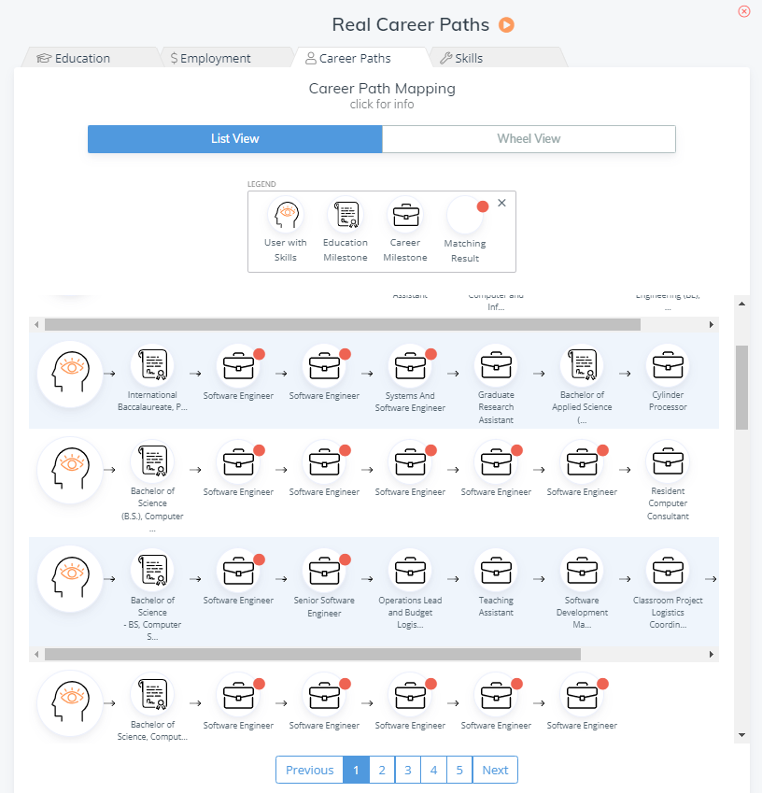
Module: Search 360
With this Module you can…
Search our entire dataset of 135+ million people
Search by Job Title or by Major
View education outcomes, salary information, common jobs, top companies, and skills data for the people in your search
Explore career paths from real people

Slide 9
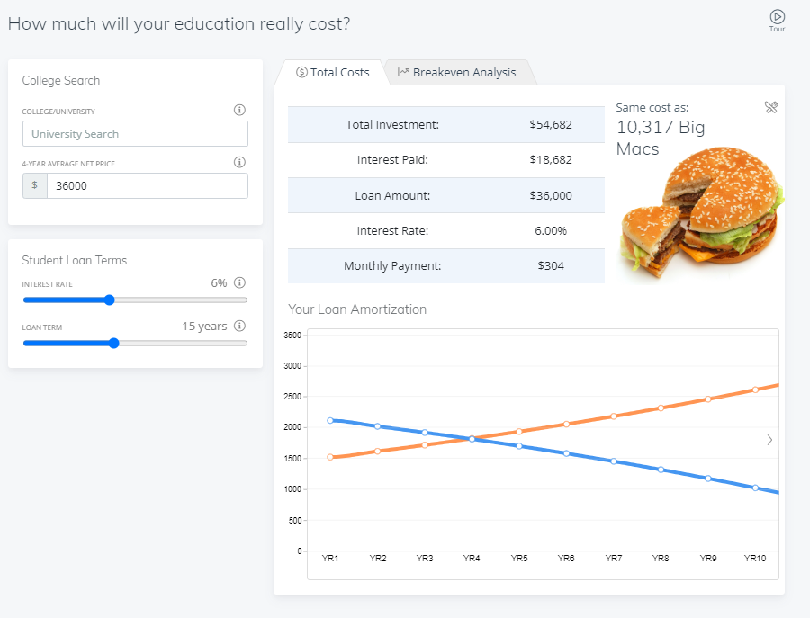
Module: Tuition
With this Module you can…
Put in your expected cost of education and your student loan terms to calculate your likely monthly payment
Play around with different possible salary outcomes to see how they will influence your student loan repayment

Slide 10
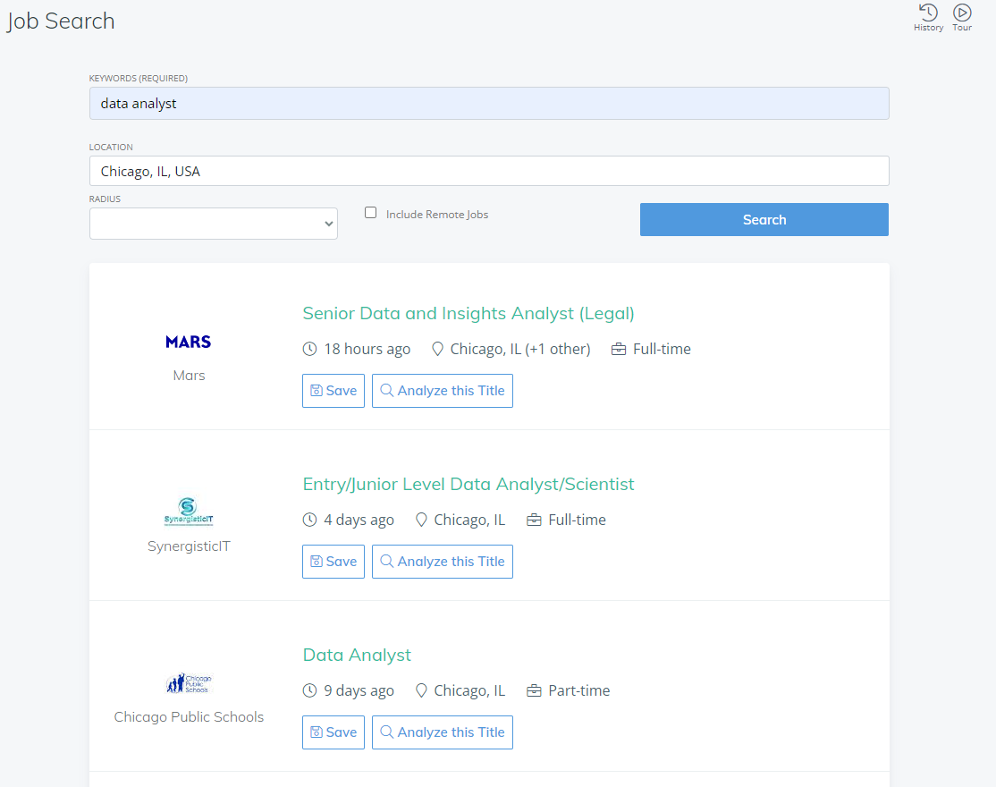
Module: Job Board
With this Module you can…
Search for jobs that are currently posted publicly online
Search for remote jobs and/or jobs in your desired city, state, or zip code
View and save job postings that interest you

Slide 11
Next Steps & Resources
Log into the platform and get started! **WEBSITE LINK**
Make an appointment with your Career Advisor **LINK**
Have questions? Send a chat message to the Steppingblocks team within the Digital Career Counselor platform
Check out Steppingblocks resources:
Digital Career Counselor Guide
Steppingblocks Help Center: Digital Career Counselor
Next Steps for Students
Interview Guide for Students
Skills Employers Seek

